Slide 1
Electric Field Calculation in High Voltage Systems using Charge simulation method (CSM)
Presented BY:
Kazi Masudur Rahaman (1759002)
Diptarup Chakraborty (1759003)
Niraj Kumar (1759013)
AJAY YADAV (1759041)
Shruti (1759047)
Karan Sagar (1759060)

Slide 2
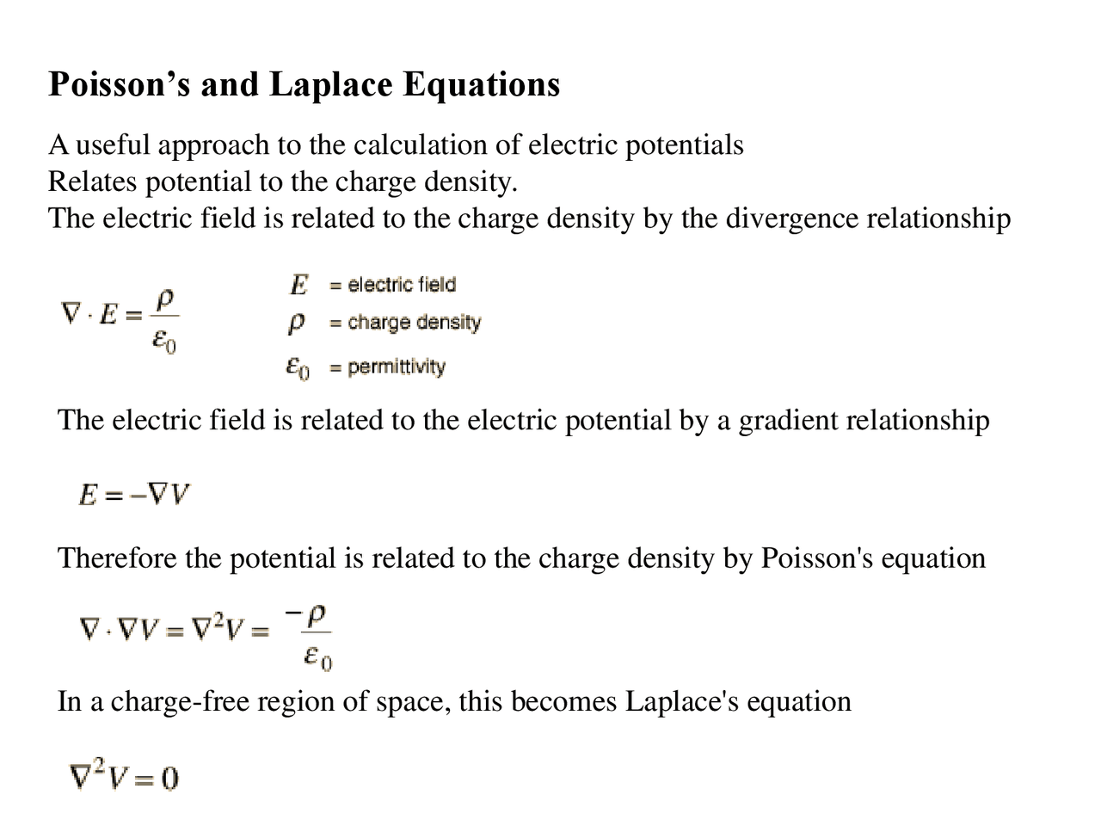
Introduction
Why do we need CSM?
The calculation of electric fields requires the solution of Laplace's and Poisson's equation (shown alongside) with boundary conditions satisfied. This can be done either by analytical or numerical methods.
In many instances, physical systems are so complex that analytical solutions are difficult or impossible, and hence numerical methods are commonly used for engineering applications.
The available numerical methods are normally based on difference or integral concepts.
Charge Simulation Method (CSM) is a very simple technique that uses discrete charges. It is very successful in most of the high voltage field problems. It is applicable to systems having more than one dielectric medium. This method is also very suitable for 3-D fields with or without symmetry.

Slide 3
Introduction
Properties of CSM
Unlike FDM and FEM, CSM divides only boundary surfaces, i.e., electrode surfaces and dielectric interfaces, into number of sub regions and boundary charges or charge densities are taken as unknowns, which can be solved through a set of coupled simultaneous linear equations which approximate Laplace's or Poisson's equation.
The amount of human time and effort needed for subdivision is greatly reduced in CSM.
CSM requires no or very little numerical integration in constructing the coefficient matrix for unknown charges and then in obtaining the field intensity. This makes the programming easier and the computation faster.
CSM has a disadvantage in that the electric field including very thin electrodes is difficult to calculate because fictitious charges approximating the field must be placed inside the electrodes.

Slide 4
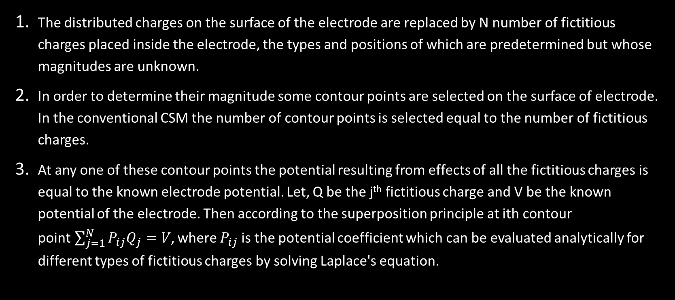
BASIC PRINCIPLE
The distributed charges on the surface of the electrode are replaced by N number of fictitious charges placed inside the electrode, the types and positions of which are predetermined but whose magnitudes are unknown.
In order to determine their magnitude some contour points are selected on the surface of electrode. In the conventional CSM the number of contour points is selected equal to the number of fictitious charges.
At any one of these contour points the potential resulting from effects of all the fictitious charges is equal to the known electrode potential. Let, Q be the j^{th} fictitious charge and V be the known potential of the electrode. Then according to the superposition principle at ith contour point$\sum_{j=1}^{N}{P_{ij}Q_{j}}=V$, where $P_{ij}$ is the potential coefficient which can be evaluated analytically for different types of fictitious charges by solving Laplace's equation.

Slide 5
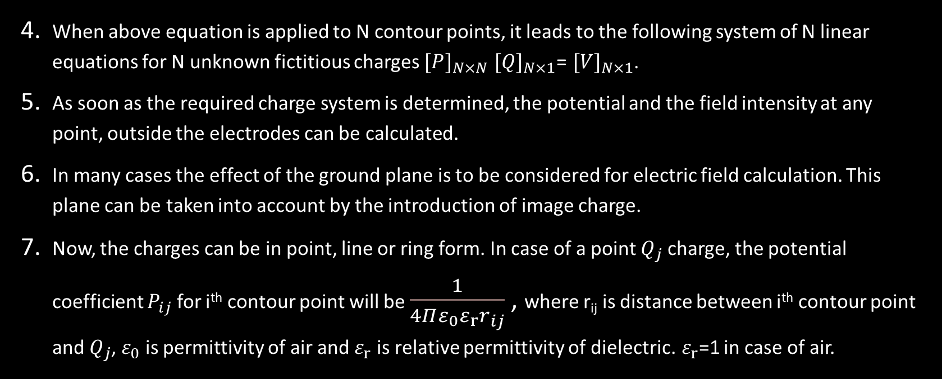
BASIC PRINCIPLE
When above equation is applied to N contour points, it leads to the following system of N linear equations for N unknown fictitious charges ${[P]}_{N×N}$ ${[Q]}_{N×1}$= ${[V]}_{N×1}$.
As soon as the required charge system is determined, the potential and the field intensity at any point, outside the electrodes can be calculated.
In many cases the effect of the ground plane is to be considered for electric field calculation. This plane can be taken into account by the introduction of image charge.
Now, the charges can be in point, line or ring form. In case of a point $Q_{j}$ charge, the potential coefficient $P_{ij}$ for i^{th} contour point will be $\frac{1}{4Πε_{0}{ε_{r}r}_{ij}}$ , where r_{ij} is distance between i^{th} contour point and $Q_{j}$, $ε_{0}$ is permittivity of air and $ε_{r}$ is relative permittivity of dielectric. $ε_{r}$=1 in case of air.

Slide 6
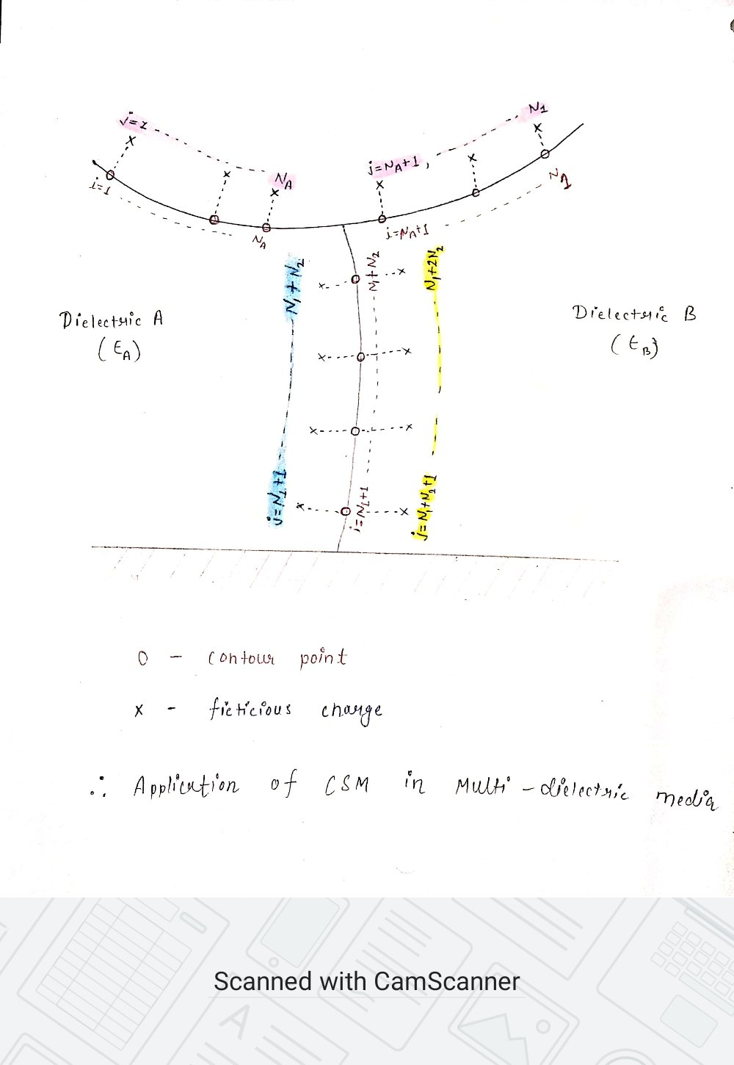
CSM in multi-dielectric media
The dipoles are realigned in dielectric media under the influence of the applied voltage, producing a net surface charge on the dielectric interface. Thus, in addition to the electrodes, each dielectric interface needs to be simulated by fictitious charges.
Due to polarization, the charges produced in one dielectric are considered to be located in the adjacent dielectric. So if, for example, dielectrics A and B are adjacent, charges in dielectric A actually exhibit characteristics (permittivity, potential coefficient, etc.) of dielectric B and vice versa.
Here, it is important to note that the dielectric boundary does not correspond to an equipotential surface. Moreover, it must be possible to calculate the electric field on both sides of the dielectric boundary.
In the simple example here, there are N1 number of charges and contour points to simulate the electrode, of which NA are on the side of dielectric A and (N1- NA) are on the side of dielectric B. These N1 charges are valid for field calculation in both dielectrics. At the dielectric interface there are N2 contour points (N1+1,...N1+N2) with N2 charges ( N1+1,...N1+N2) in dielectric A, valid for dielectric B and N2 charges (N1+N2+,...,N1+2N2) in dielectric B, valid for dielectric A. Altogether there are (N1+N2) number of contour points and (N1+ 2N2) number of charges.

Slide 7
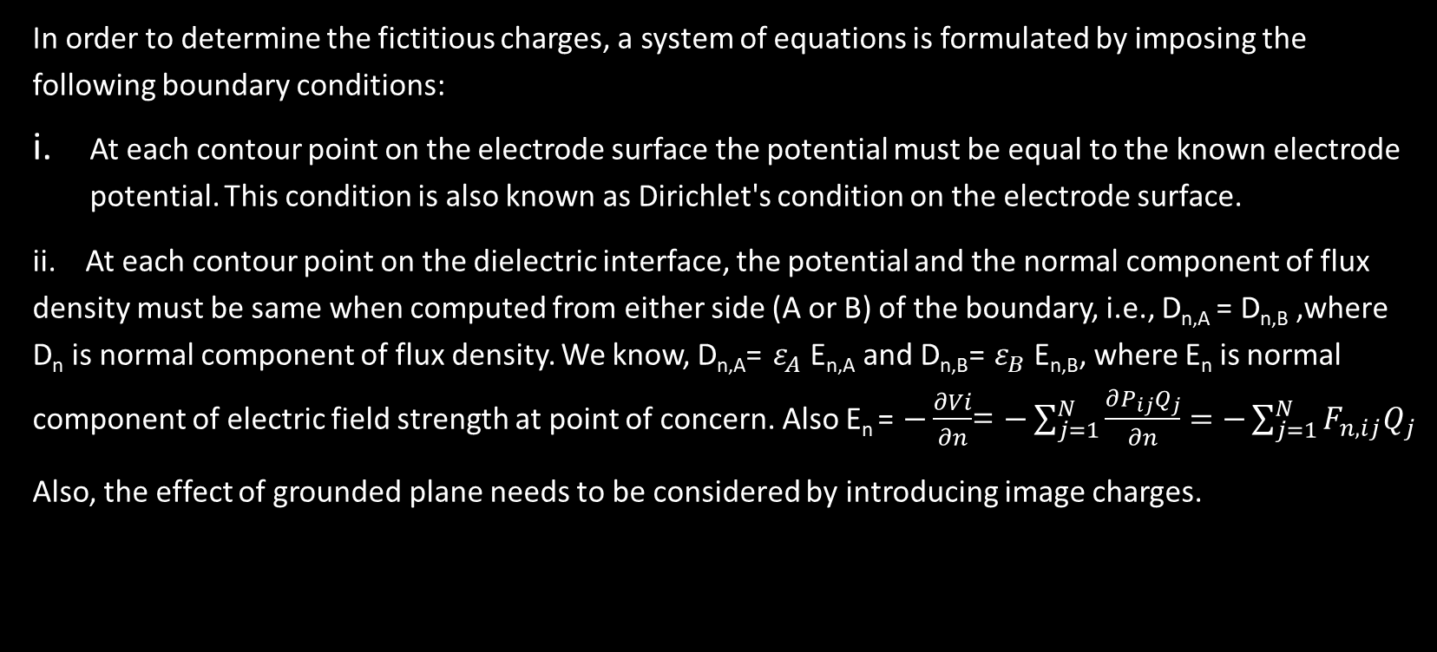
CSM in multi-dielectric media
In order to determine the fictitious charges, a system of equations is formulated by imposing the following boundary conditions:
At each contour point on the electrode surface the potential must be equal to the known electrode potential. This condition is also known as Dirichlet's condition on the electrode surface.
ii. At each contour point on the dielectric interface, the potential and the normal component of flux density must be same when computed from either side (A or B) of the boundary, i.e., D_{n,A} = D_{n,B} ,where D_{n} is normal component of flux density. We know, D_{n,A}= $ε_{A}$E_{n,A} and D_{n,B}= $ε_{B}$E_{n,B}, where E_{n} is normal component of electric field strength at point of concern. Also E_{n} = $−\frac{∂Vi}{∂n}$= $−\sum_{j=1}^{N}{\frac{∂P_{ij}Q_{j}}{∂n}=}$ $−\sum_{j=1}^{N}{F_{n,ij}Q_{j}}$
Also, the effect of grounded plane needs to be considered by introducing image charges.

Slide 8
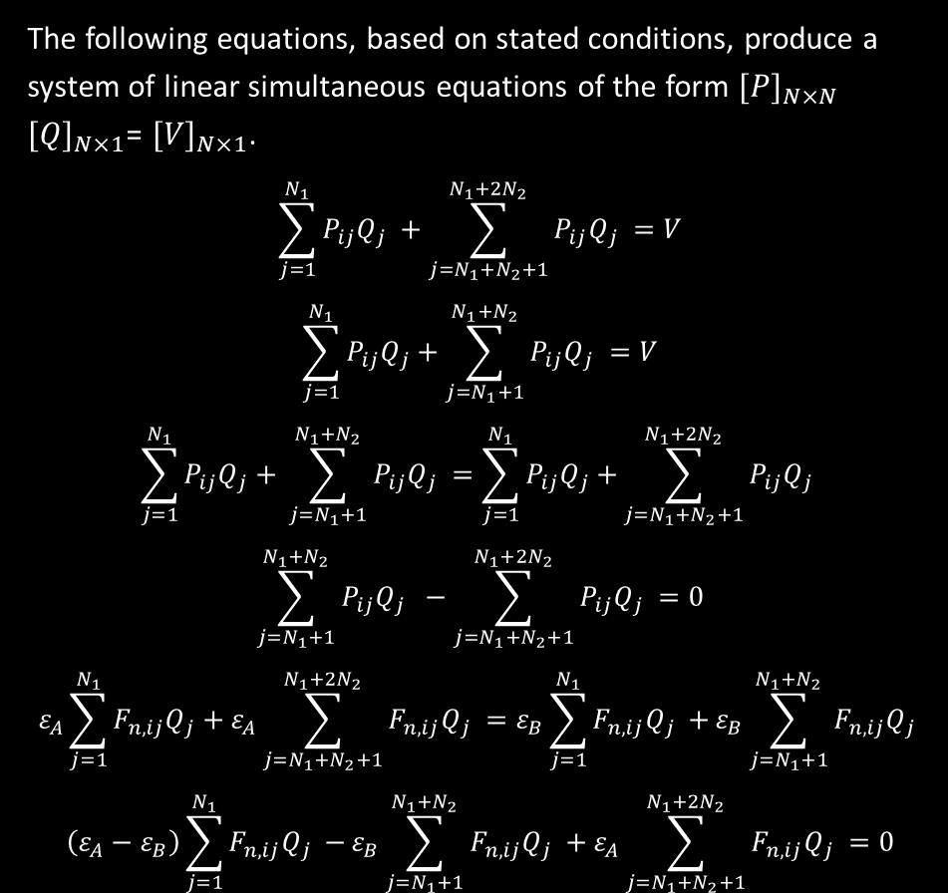
CSM in multi-dielectric media
The following equations, based on stated conditions, produce a system of linear simultaneous equations of the form ${[P]}_{N×N}$ ${[Q]}_{N×1}$= ${[V]}_{N×1}$.
$$\sum_{j=1}^{N_{1}}{P_{ij}Q_{j} +\sum_{j=N_{1}+N_{2}+1}^{N_{1}+{2N}_{2}}{P_{ij}Q_{j} }=V}$$
$$\sum_{j=1}^{N_{1}}{P_{ij}Q_{j}+\sum_{j=N_{1}+1}^{N_{1}+N_{2}}{P_{ij}Q_{j} }=V}$$
$$\sum_{j=1}^{N_{1}}{P_{ij}Q_{j}+} \sum_{j=N_{1}+1}^{N_{1}+N_{2}}{P_{ij}Q_{j} =\sum_{j=1}^{N_{1}}{P_{ij}Q_{j}+}\sum_{j=N_{1}+N_{2}+1}^{N_{1}+{2N}_{2}}{P_{ij}Q_{j} }}$$
$$\sum_{j=N_{1}+1}^{N_{1}+N_{2}}{P_{ij}Q_{j} −\sum_{j=N_{1}+N_{2}+1}^{N_{1}+{2N}_{2}}{P_{ij}Q_{j} }=0}$$
$${\left.ε_{A}\right.\sum_{j=1}^{N_{1}}{F_{n,ij}Q_{j}+ε_{A}\sum_{j=N_{1}+N_{2}+1}^{N_{1}+{2N}_{2}}{F_{n,ij}Q_{j} }=\left.ε_{B}\right.\sum_{j=1}^{N_{1}}{F_{n,ij}Q_{j} +}}ε}_{B}\sum_{j=N_{1}+1}^{N_{1}+N_{2}}{F_{n,ij}Q_{j} }$$
$$\left(ε_{A}−ε_{B}\right)\sum_{j=1}^{N_{1}}{F_{n,ij}Q_{j} −}ε_{B}\sum_{j=N_{1}+1}^{N_{1}+N_{2}}{F_{n,ij}Q_{j} +ε_{A}\sum_{j=N_{1}+N_{2}+1}^{N_{1}+{2N}_{2}}{F_{n,ij}Q_{j} }=0}$$
…(i)
…(ii)
…(iii)
…(iv)

Slide 9
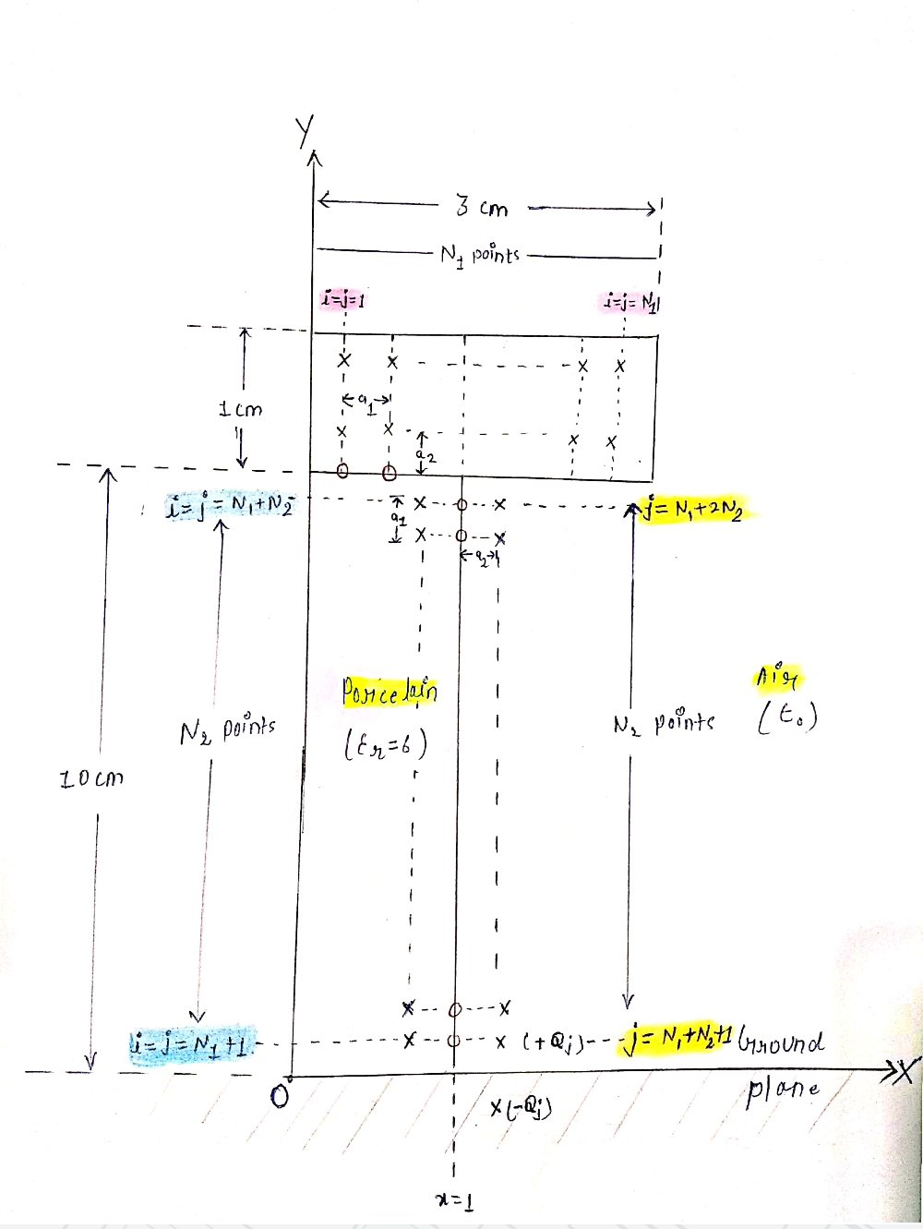
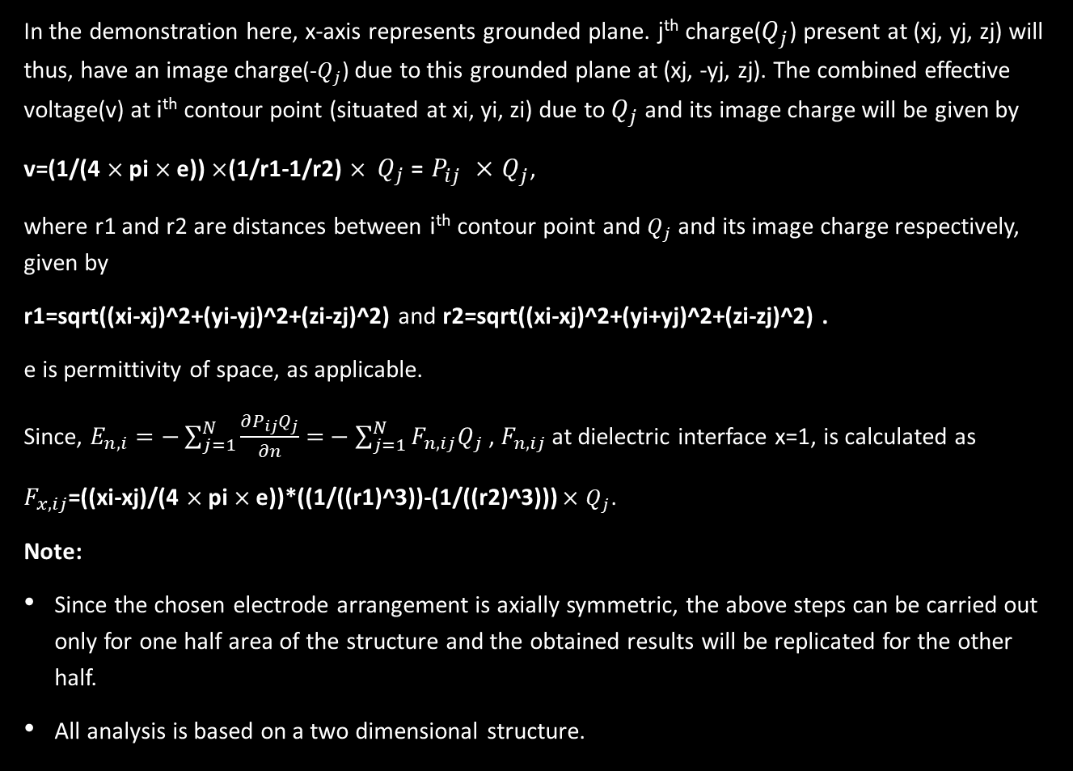
Programming logic
In the demonstration here, x-axis represents grounded plane. j^{th} charge($Q_{j}$) present at (xj, yj, zj) will thus, have an image charge(-$Q_{j}$) due to this grounded plane at (xj, -yj, zj). The combined effective voltage(v) at i^{th} contour point (situated at xi, yi, zi) due to $Q_{j}$ and its image charge will be given by
v=(1/(4 $×$pi $×$e)) $×$(1/r1-1/r2) $× Q_{j}$= $P_{ij} ×$ $Q_{j}$,
where r1 and r2 are distances between i^{th} contour point and $Q_{j}$ and its image charge respectively, given by
r1=sqrt((xi-xj)^2+(yi-yj)^2+(zi-zj)^2) and r2=sqrt((xi-xj)^2+(yi+yj)^2+(zi-zj)^2) .
e is permittivity of space, as applicable.
Since, $E_{n,i}=−\sum_{j=1}^{N}{\frac{∂P_{ij}Q_{j}}{∂n}=}−\sum_{j=1}^{N}{F_{n,ij}Q_{j}}$ , $F_{n,ij}$ at dielectric interface x=1, is calculated as
$F_{x,ij}$=((xi-xj)/(4 $×$pi $×$e))*((1/((r1)^3))-(1/((r2)^3))) $×$ $Q_{j}$.
Note:
Since the chosen electrode arrangement is axially symmetric, the above steps can be carried out only for one half area of the structure and the obtained results will be replicated for the other half.
All analysis is based on a two dimensional structure.

Slide 10
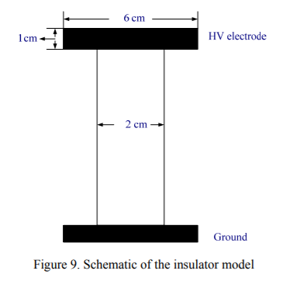
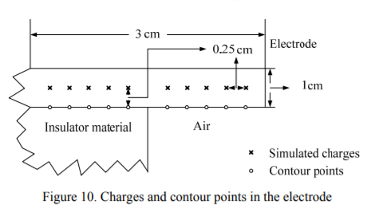
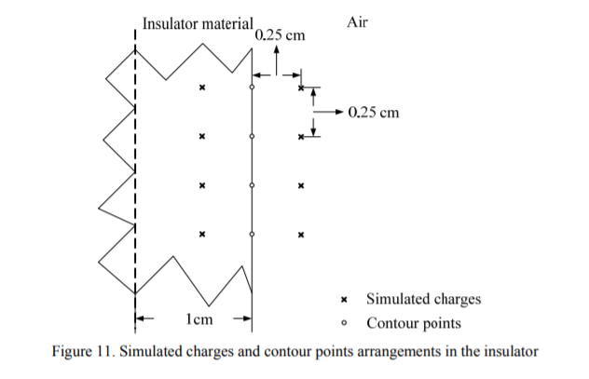
Programming logic

Slide 11
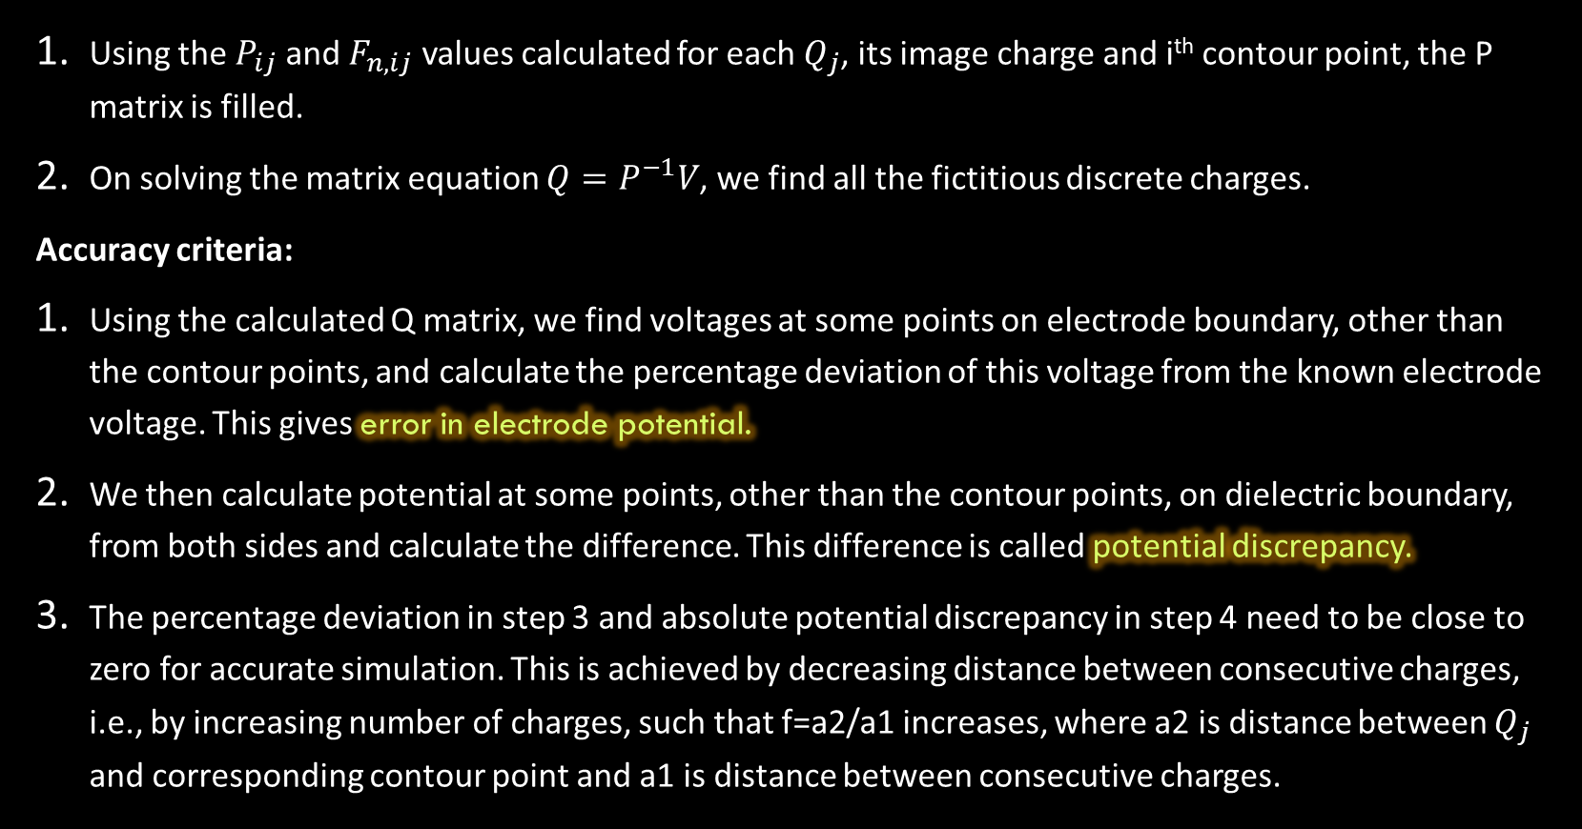
Programming logic
Using the $P_{ij}$ and $F_{n,ij}$ values calculated for each $Q_{j}$, its image charge and i^{th} contour point, the P matrix is filled.
On solving the matrix equation $Q=P^{−1}V$, we find all the fictitious discrete charges.
Accuracy criteria:
Using the calculated Q matrix, we find voltages at some points on electrode boundary, other than the contour points, and calculate the percentage deviation of this voltage from the known electrode voltage. This gives error in electrode potential.
We then calculate potential at some points, other than the contour points, on dielectric boundary, from both sides and calculate the difference. This difference is called potential discrepancy.
The percentage deviation in step 3 and absolute potential discrepancy in step 4 need to be close to zero for accurate simulation. This is achieved by decreasing distance between consecutive charges, i.e., by increasing number of charges, such that f=a2/a1 increases, where a2 is distance between $Q_{j}$ and corresponding contour point and a1 is distance between consecutive charges.

Slide 12
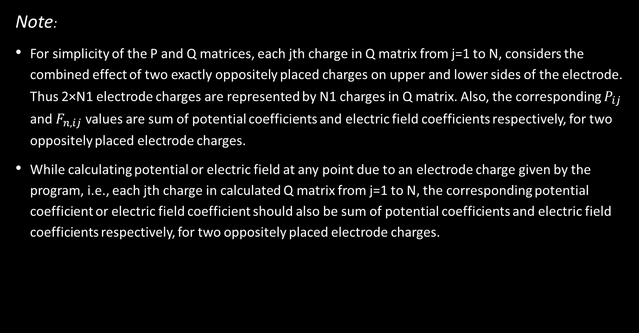
Programming logic
Note:
For simplicity of the P and Q matrices, each jth charge in Q matrix from j=1 to N, considers the combined effect of two exactly oppositely placed charges on upper and lower sides of the electrode. Thus 2×N1 electrode charges are represented by N1 charges in Q matrix. Also, the corresponding $P_{ij}$ and $F_{n,ij}$ values are sum of potential coefficients and electric field coefficients respectively, for two oppositely placed electrode charges.
While calculating potential or electric field at any point due to an electrode charge given by the program, i.e., each jth charge in calculated Q matrix from j=1 to N, the corresponding potential coefficient or electric field coefficient should also be sum of potential coefficients and electric field coefficients respectively, for two oppositely placed electrode charges.

Slide 13
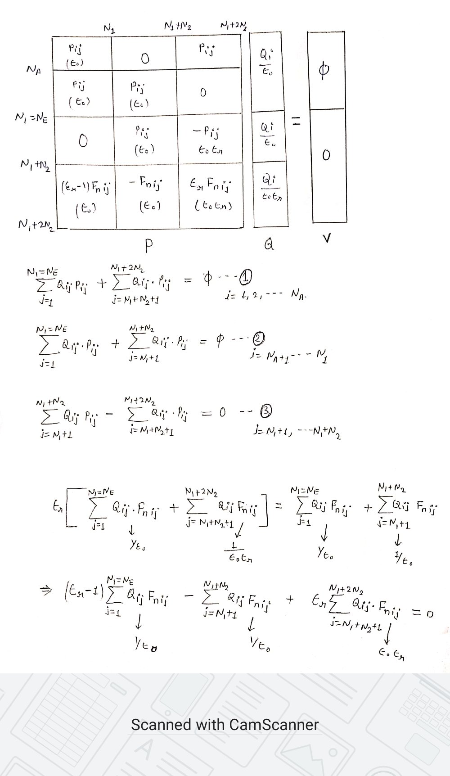
Programming logic

Slide 14
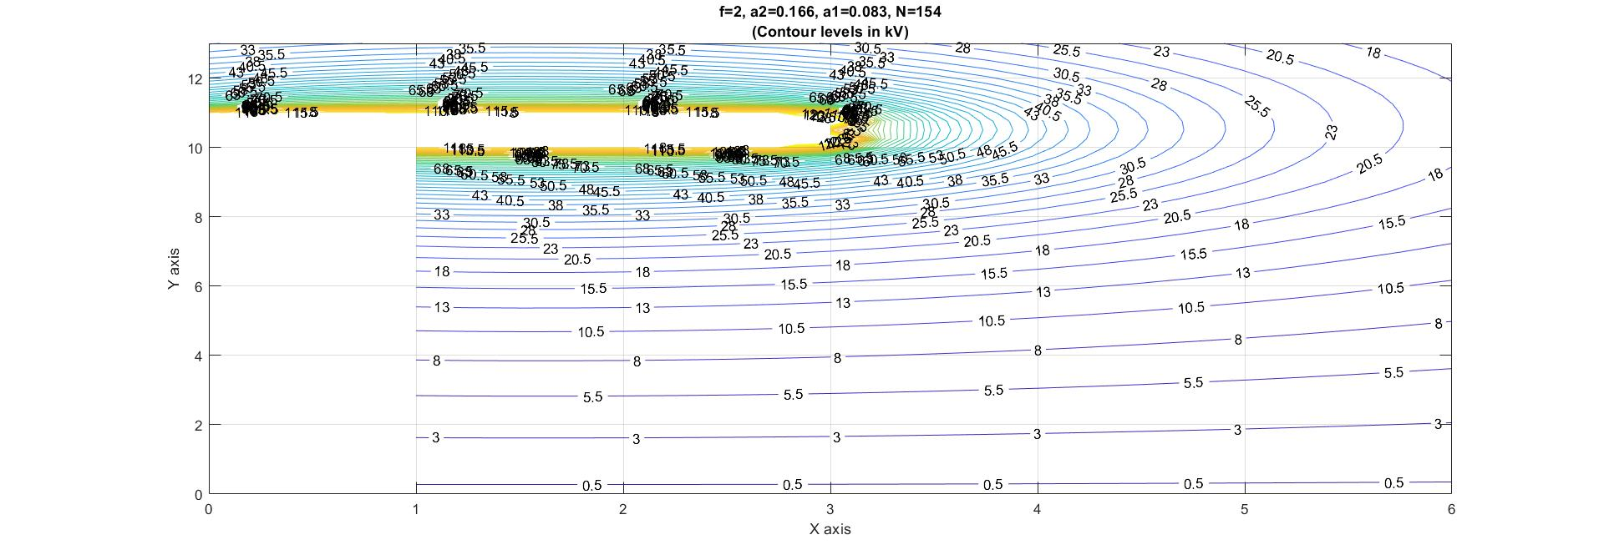
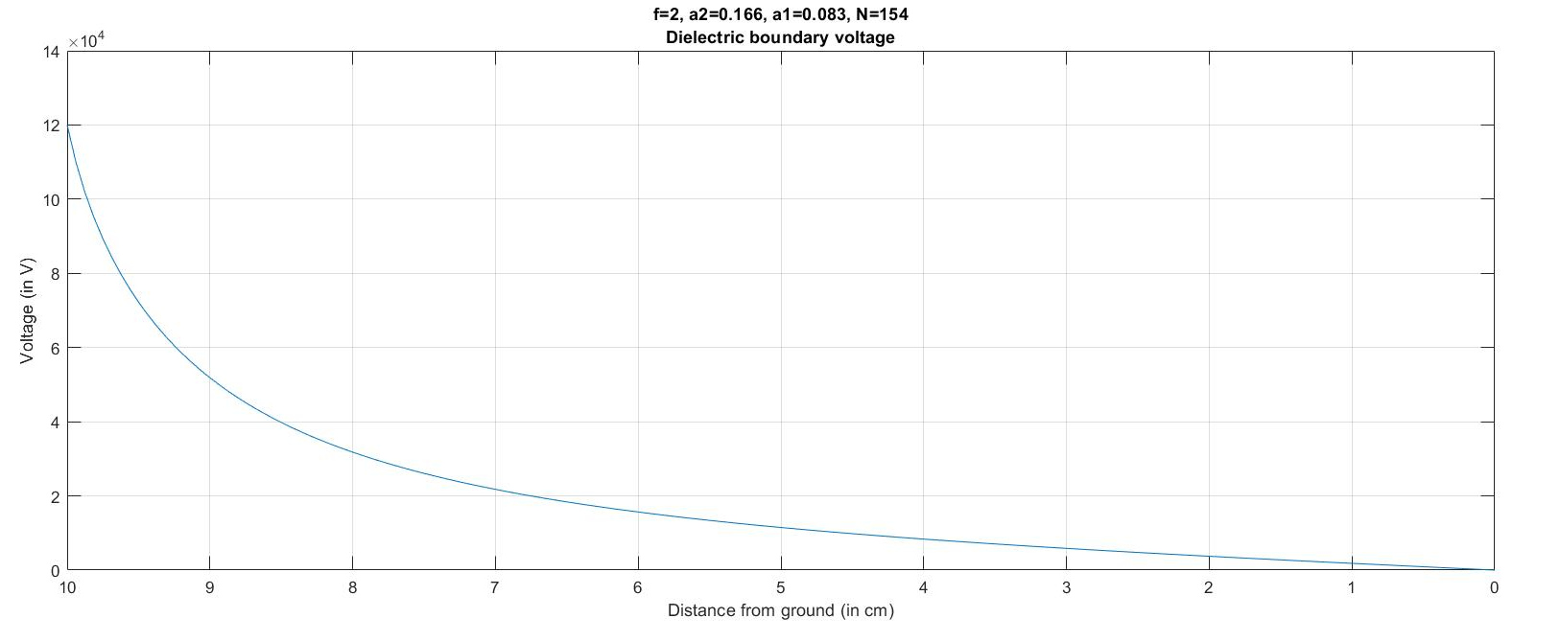
RESULTS

Slide 15
RESULTS
f value |  | RMS Electrode Potential error | RMS Potential discrepancy
 |  | (in %) | (absolute)
f=0.5 | a2=0.125,a1=0.25 | 8.374178337 | 1.37721E-12
 | N=50
f=1 | a2=a1=0.167 | 3.006505257 | 1.95109E-12
 | N=76
f=1.5 | a2=0.1875,a1=0.125 | 1.434459549 | 7.64E-12
 | N=102
f=2 | a2=0.166,a1=0.083 | 0.687046766 | 4.91219E-12
 | N=154
f=3 | a2=0.1875,a1=0.0625 | 0.294091435 | 9.43044E-12
 | N=206
f=4 | a2=0.2,a1=0.05 | 0.232924014 | 1.13699E-11
 | N=258

Slide 16
Conclusion
The CSM method produces an accurate enough estimation of charge system to satisfy boundary conditions, using simple and small number of equations.
For multi-dielectric system, CSM can be the preferred choice, as initial input boundary equations are easy to form under discrete charges.
Verification of the simulated charge system at arbitrary points also becomes easier due to discrete charges.
Increasing number of charges or decreasing distance between consecutive charges greatly reduces errors, but also decreases computational efficiencies. In the simulated results, an f value above 1 and upto 2 produces acceptable errors but any value above that produces negligible decrease in error and instead increases mathematical complexity massively.
The method can be made faster and more efficient by using genetic algorithm to determine the location and type(point, line or ring) of charges.

Slide 17
References
IEEE Transaction papers: www.ieee.org , https://sci-hub.se
Wang Erzhi, Han Changwei, Liu Xiaoming and Cao Yundong. ELECTRIC FIELD CALCULATION FOR VACUUM INTERRUPTER BY OPTIMIZED CHARGE SIMULATION METHOD. XXIInd Int. Symposium on Discharges and Electrical Insulation in Vacuum-Matsue-2006
Xiaoming Lid, Yundong Cao, Enhi Wang, Li Jin. CALCULATION OF ELECTRIC FIELD IN VACUUM CIRCUIT-BREAKER USING-OPTIMIZED AND TRADITIONAL CSM. XXth International Symposium on Discharges and Electrical Insulation in Vacuum-Tours-2002
H. Singer H. Steinbigler P. Weiss. A CHARGE SIMULATION METHOD FOR THE CALCULATION OF HIGH VOLTAGE FIELDS. Technical University, Munich, Germany.
Jiahong He. ELECTRIC POTENTIAL AND FIELD CALCULATION OF HVDC COMPOSITE INSULATORS BY CHARGE SIMULATION METHOD. Arizona State University, December 2013.

